Slide 1
Newborn EEG QUIZES
M. Mohammadi MD
Professor, Child Neurology

Slide 2
با سلام و آرزوی موفقیت لطفاً نام پدیده الکتروانسفالوگرافیک را بعداز شماره مربوط به کوئیز بنویسید. تاکید میشود که نام پدیده کافیست و از توضیح پرهیز فرمایید.

Slide 3
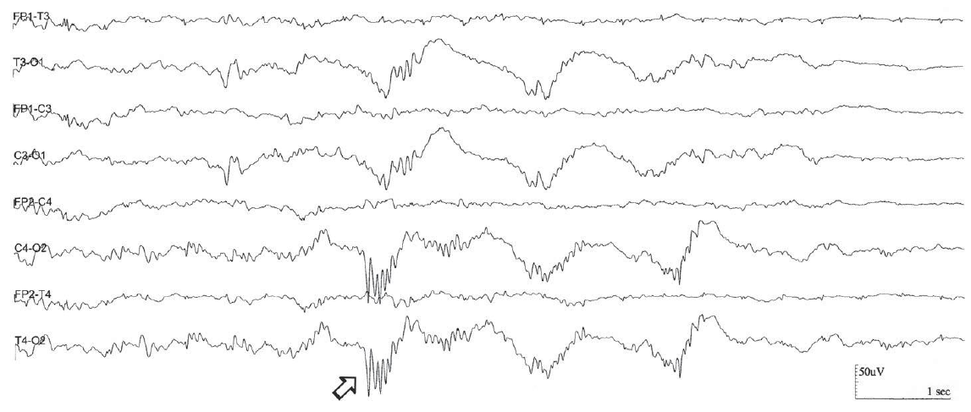
QUIZ
1
Notes:
Delta Brushes (Occipital Predominance); Monorhythmic Occipital Delta Activity. EEG of a 31-week CA infant with HIE showed bilateral synchronous
monorhythmic occipital delta activity intermixed with delta brushes (DBs) in the occipital regions (arrow).

Slide 4
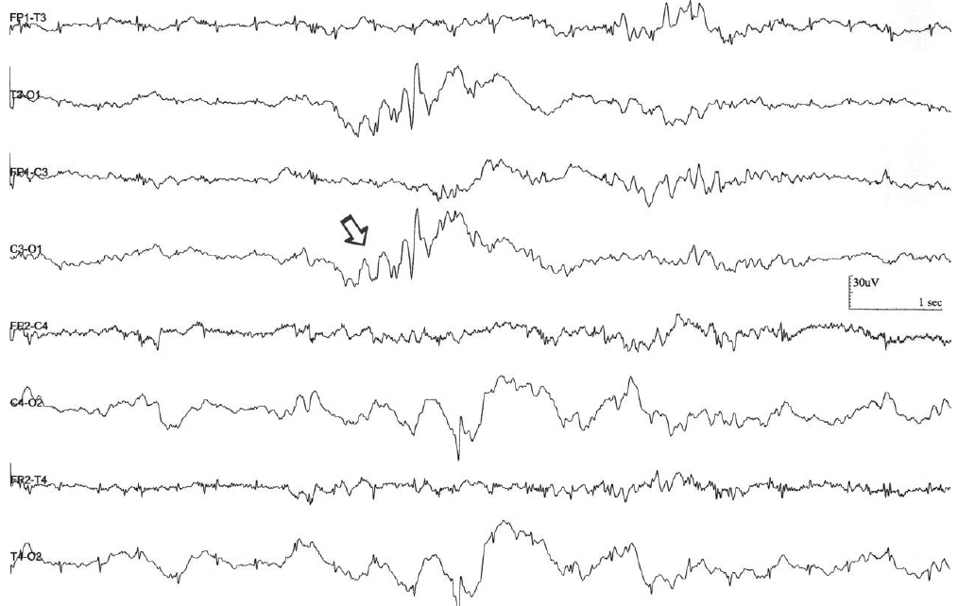
QUIZ
2
Notes:
Sharp Theta Rhythm on the Occipital Areas of Prematures (STOP). STOP refers to 5–6 Hz sharp-contoured theta activity, either unilateral or bilateral and maximal in the occipital regions. The STOP pattern is similar to temporal theta bursts in configuration, but is faster in frequency and lower in amplitude. The incidence was highest at the youngest age, 22–25 weeks CA, decreasing to zero near term. In the youngest age these rhythms are mainly bilateral; in the older neonates they are unilateral. STOP is seen more often in active sleep, but is reduced in incidence in patients with abnormal slow waves, ictal or immature patterns. Right-sided STOP was more frequently associated with abnormal EEGs, especially in males with right-sided sharp waves, often noted in the patients with seizures and intraventricular hemorrhages.

Slide 5
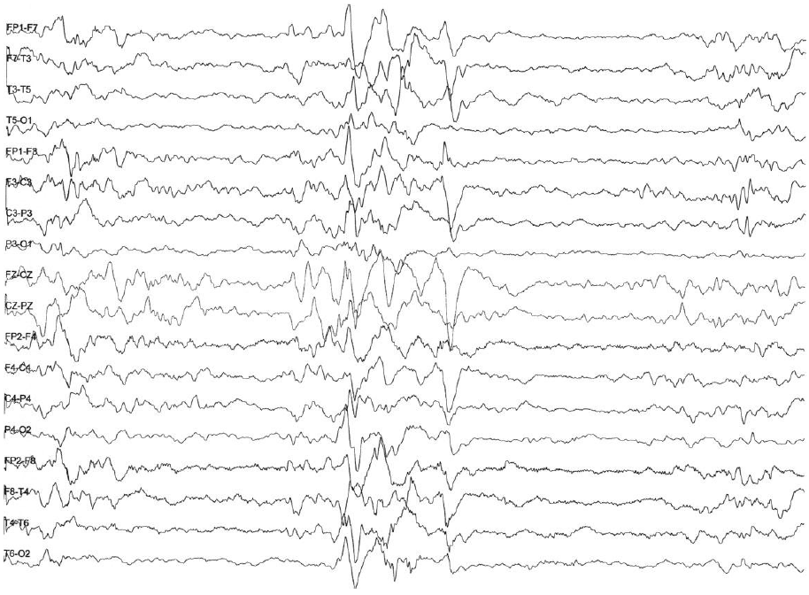
QUIZ
3
Notes:
Trace Alternant. Background activity in NREM sleep is discontinuous before 36 weeks CA. Between 36 and 38 weeks CA, two NREM EEG patterns present
(1) continuously diff use high-voltage, slow-wave activity and (2) trace alternant—this consists of bursts of activity (delta activity admixed with faster frequencies) with an amplitude of 50–300 μV, interspersed between periods of decreased amplitude (resembles the EEG during wakefulness and active sleep and consists of mixed frequencies with amplitudes of 25–50- μV). Trace alternant begins to wane by 38–40 weeks CA and disappears by 44–46 weeks CA when it is replaced by continuous slow-wave activity. After that, sleep spindles present at around 46 weeks CA.
The distinction between trace alternant and trace discontinu is the amplitude of IBI (interburst interval). In trace discontinu, it is less than 25 μV, whereas in trace alternant, it is more than 25 μV.

Slide 6
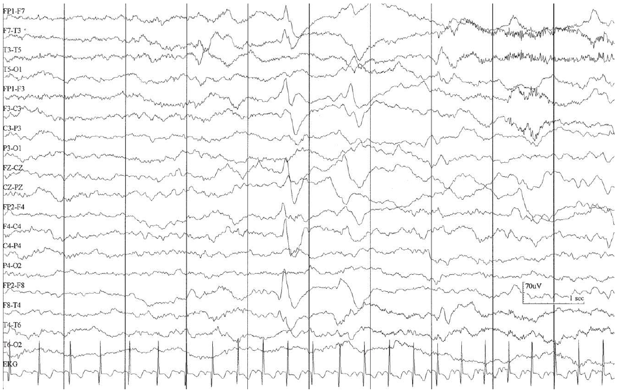
QUIZ
4
Notes:
Frontal Sharp Transients (encouche frontales). Frontal sharp transients (encoches frontales) are physiologic findings described as isolated high amplitude (50 to >150 μV), broad, biphasic transients (either negative–positive or positive–negative) with blunt configuration, seen maximally in frontal–prefrontal regions (Fp3–Fp4). They usually are isolated or occur in brief runs, alone or in combination with anterior slow dysrhythmia, symmetrically, bilaterally, and synchronously. They occur in transition from active to early quiet sleep. Although the premature form, which are polyphasic and very high amplitude may appear very early at 26–31 weeks CA, the typical biphasic FST are maximally expressed at 35–36 weeks, are diminished in number and voltage after 44 weeks CA, are rarely seen during sleep after 46 weeks CA, and are absent at 48 weeks CA.
Minor criteria for pathologic FSTs include (1) excessive amount, (2) excessive duration, (3) high amplitude, (4) occurrence in active sleep/wakefulness, (5) atypical morphology, (6) marked asymmetry, and (7) FSTs beyond 48 weeks.

Slide 7
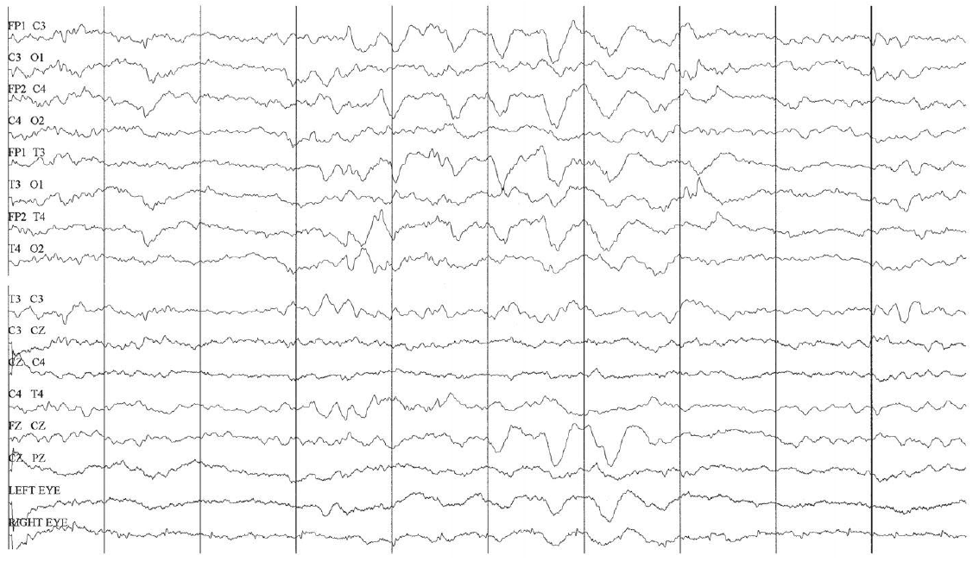
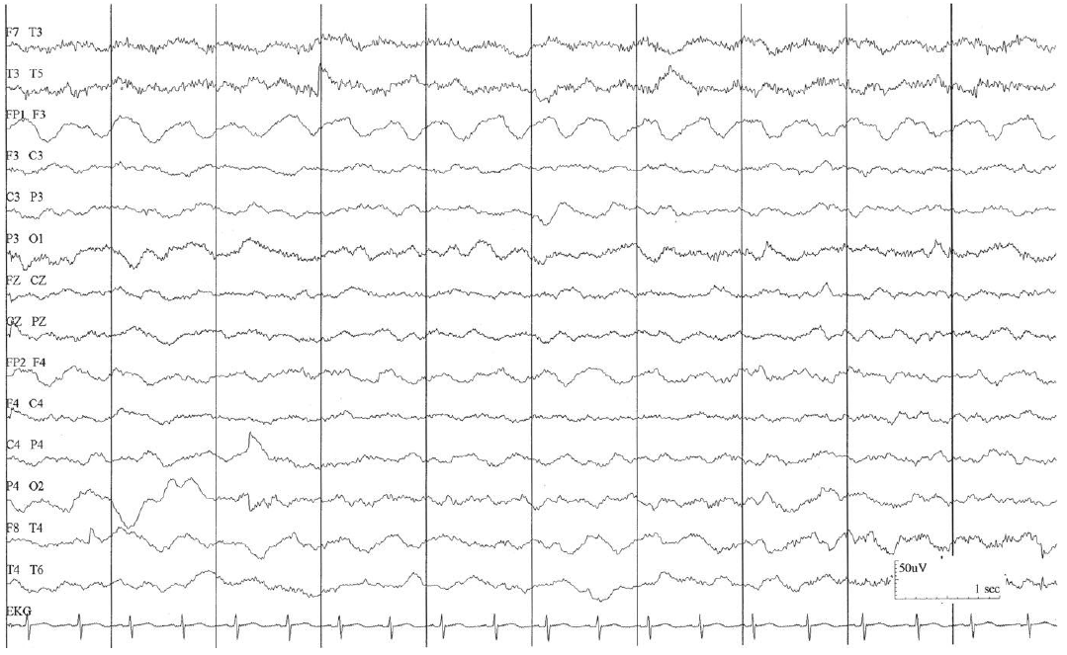
5
Notes:
Anterior Slow Dysrhythmia; (Anterior Dysrhythmia, Bifrontal Delta Activity). A 40 weeks CA infant with apnea and cyanosis. EEG shows “anterior slow dysrhythmia,” which is described as intermittent semirhythmic 1.5- to 2-Hz high-voltage delta activity (50- to 100 μV) in the frontal regions bilaterally. Anterior slow dysrhythmia is usually admixed with frontal sharp transients. It occurs most prominently during transitional sleep. It is a normal developmental EEG pattern. However, when it is abundant, persistently asymmetric, and high in amplitude or dysmorphic, it may be considered abnormal.

Slide 8
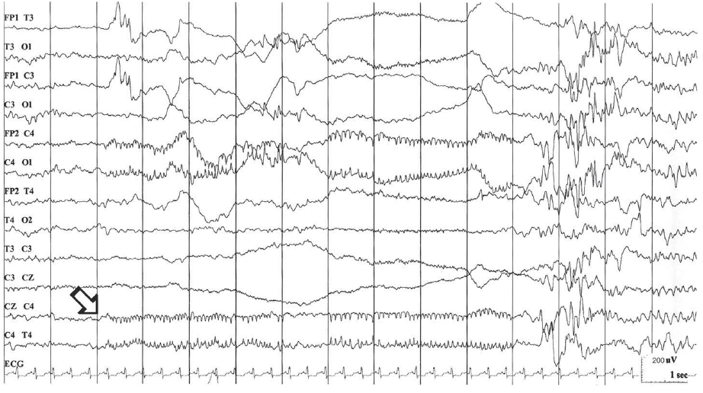
6
Notes:
Zip-Like Electrical Discharges (Zips). A 30-day-old full-term newborn with pulmonary hypoplasia associated with diaphragmatic hernia and severe hypoxic ischemic encephalopathy, who developed frequent clonic jerking of the left arm. Ictal EEG shows low-voltage rhythmic, arc-like spikes in the right central region (open arrow)
superimposed on very low-voltage background activity. “Zip-like electrical discharges (Zips)” is a common ictal EEG pattern in neonates, which consists of focal episodic rapid spikes of accelerating and decelerating speed that look like zippers. Zips may be associated with subclinical, subtle, focal clonic, and tonic seizures. Zips of subtle seizures are often multifocal and of shifting localization.

Slide 9
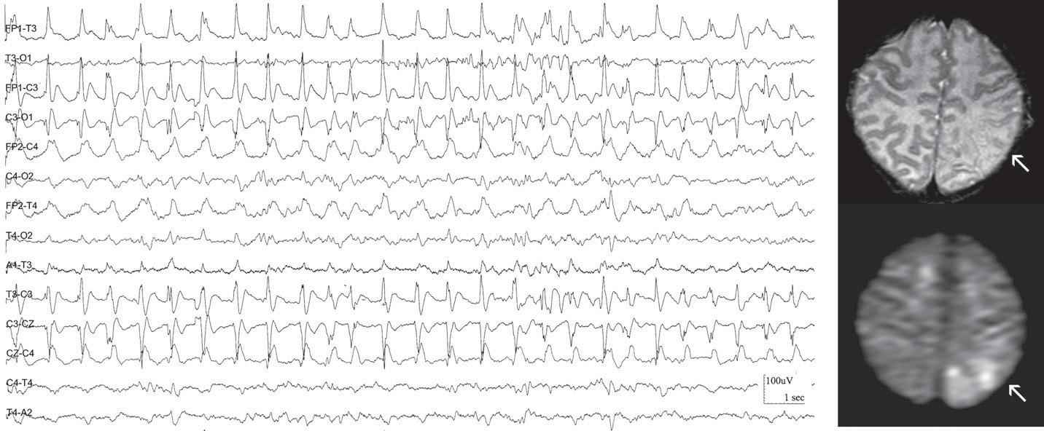
7
Notes:
Focal Clonic Seizure; Neonatal Stroke Due to Systemic Infection. A 7-day-old female with low-grade fever and frequent right arm clonic jerking. CSF
fi ndings were unremarkable. Her mother had a history of fever and URI symptoms. Hypercoagulation studies were negative. The presumptive diagnosis was neonatal stroke
caused by systemic viral infection. T2-weighted and DWI MRI support the diagnosis of stroke in the left parietal region (arrow). Ictal EEG demonstrates rhythmic spike-wave activity
in the left central region time-locked with right arm clonic jerking. Seizures were stopped after topiramate was added to phenobarbital.
Stroke or hemorrhage is the most common structural abnormality that causes focal clonic or tonic seizures. In addition, focal tonic or clonic seizures are also associated
with some metabolic conditions such as hypocalcemia, hypoglycemia, and hypomagnesemia.28 MRI, especially with diff usion-weighted imaging (DWI), is the investigation
of choice for arterial stroke in the newborn. DWI can reliably detect ischemic injury within 24 h of its onset. However, DWI may become falsely negative 1 week after stroke
(pseudonormalization), by which time established changes should be evident on conventional T1- and T2-weighted imaging.31,32

Slide 10
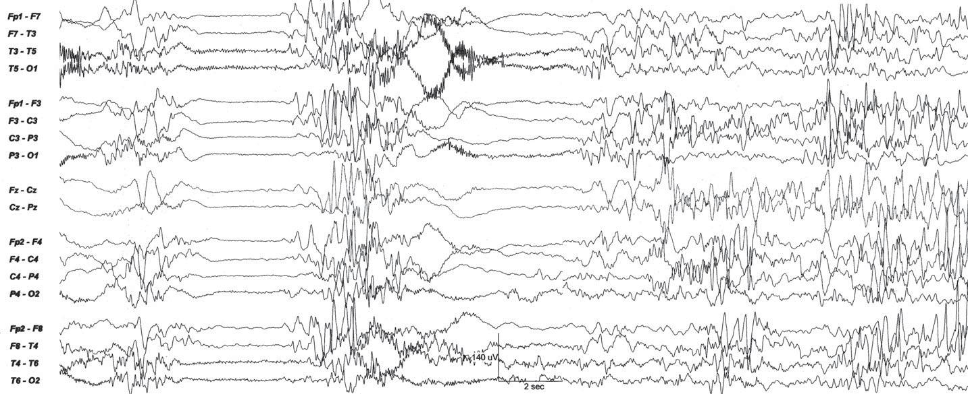
8
Notes:
Early Myoclonic Encephalopathy (EME); Pyridoxine Dependency. A 7-day-old girl with intermittent irritability, jitteriness, lethargy, and myoclonic jerks. A
subsequent gene tests confi rmed the diagnosis of pyridoxine dependency. Her MRI was unremarkable. Her initial EEG (as shown) demonstrates diff use suppression burst pattern.
After an administration of intravenous pyridoxine, the patient showed dramatic improvement in her clinical symptoms and EEG. During her subsequent neurology visits, she
continued to have no seizures and had normal developmental milestones. Her EEGs performed at 1 and 3 months of age were appropriate for age.
EME is a very rare epileptic syndrome characterized by myoclonus with onset of seizures in the neonatal period. The EEG shows suppression burst pattern. Metabolic diseases,
especially nonketotic hyperglycinemia, are usually the causes of EME. Malformation of cortical development is an uncommon etiology. Pyridoxine dependency was reported in
one patient with EME who had complete recovery after the treatment with pyridoxine. Almost all patients with EME have a very poor prognosis.37

Slide 11
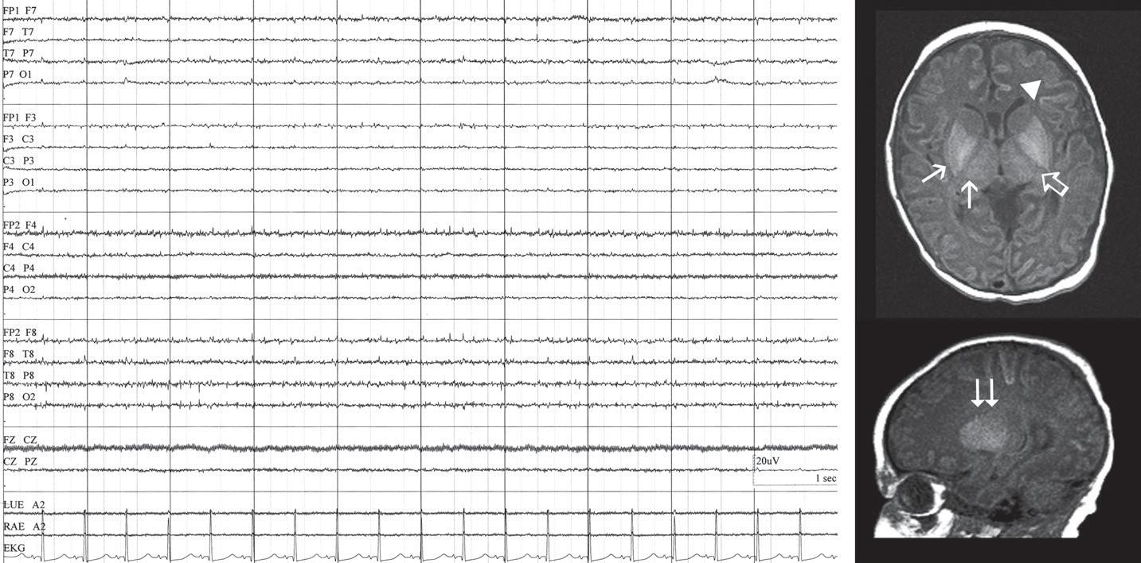
9
Notes:
Severe Hypoxic Ischemic Encephalopathy (HIE); Electrocerebral Inactivity (ECI). A 2-day-old full-term newborn with severe hypoxic ischemic encephalopathy.
Axial T1WI MR shows loss of signal in the posterior limb of internal capsule (open arrow) and increased signal in posterior putamen, GP, lateral thalamus (arrow), and cortex and
subcortical white matter. Sagittal T1WI MR shows increased signal in basal ganglion (double arrows). EEG shows no cerebral activity with the EEG sensitivity of 2 μV/mm. ECI can be
interpreted as a sign of brain death if there is absence of cortical and brainstem functions, no evidence of intoxication, and no hypothermia. Minimal technical standards for the EEG
recording in brain death by the American Encephalographic Society39 are required.

Slide 12
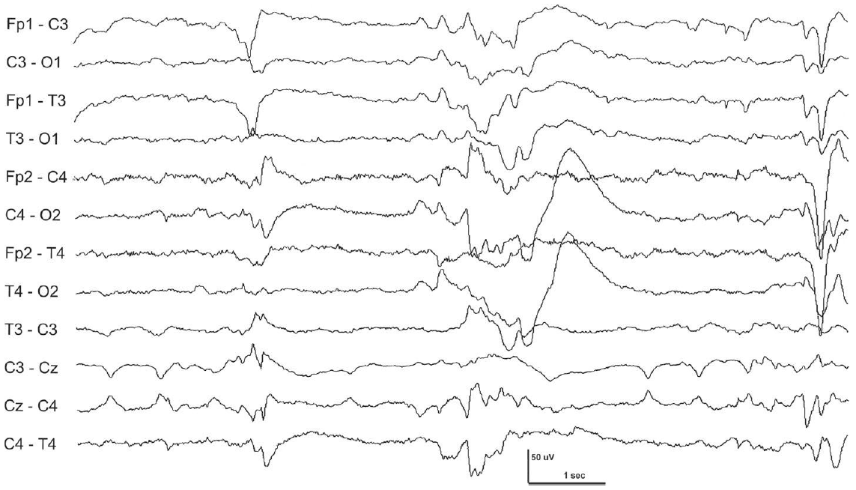
10
Notes:
Tracé Discontinu. EEG of a 28-week CA infant with severe HIE. Trace discontinu (TD) is the earliest EEG activity that appears in the viable neaonate at 22–23 weeks of gestational age (GA). It is described as short bursts, consisting of slow and fast rhythm, interspersed against a flat or quiescent background of less than 25 μV.1 At a very early age of 22–24 weeks GA, it may vary from 5 sec to 8 min.2 As age increases, the periods of inactivity shorten. The longest acceptable single interburst interval (IBI) duration has been reported to be 26 weeks CA, 46 sec; 27 weeks CA, 36 sec; 28 weeks, 27 sec3; less than 30 weeks CA, 35 sec; 31–33 weeks CA, 20 sec; 34–36 weeks CA, 10 sec; and 37–40 weeks CA, 6 sec.
The TD is also the fi rst EEG pattern occurring during quiet sleep that diff erentiates wakefulness from sleep in the premature infant at around 30–32 weeks CA. Infants less than 30 weeks CA show interhemispheric hypersynchrony in which the majority of bursts arising within the two hemispheres appear at the same time.
Note frequent low-voltage sharp waves at Cz.

Slide 13
