Slide 1
Headaches in Children
بسم‌الله الرحمن الرحيم
M. Mohammadi MD
Professor of Pediatric Neurology
Children Medical Center

Slide 2
Important Questions in hx Taking
Do you have one or more types of headache?
How did the headaches begin?
When did the headaches begin?
Are the headaches intermittent, progressive, or staying the same?
How often does each headache type occur?
Notes:
(1) Do you have one or more types of headache?
Some patients have more than one type of headache. It is important to establish the number
of different headaches the patient has and to ask questions concerning each type separately.
The physician needs to determine if the patient’s headaches are all similar or if one is more
severe (e.g., an adolescent patient who identifies mild daily headaches with superimposed
severe headaches associated with nausea and vomiting twice monthly).
(2) How did the headaches begin?
Some patients can identify factors that may initiate the headaches. They may be physical
(i.e., head trauma) or psychologic (e.g., parental separation, the death of a close relative or
friend, a move to another community).
(3) When did the headaches begin?
Whether the headaches have been present for days, weeks, months, or years needs to be
documented. In younger children, the parents will supply this information. The longer the
headache has been present without symptoms of increased intracranial pressure or
progressive neurologic signs the less likely it is an organic process.Migraine frequently has its
onset in the first decade of life, whereas daily nonprogressive headaches begin in adolescence.
(4) Are the headaches intermittent, progressive, or staying the same?
The temporal pattern of each headache needs to be established (see Figures 2–1 and 2–2).8
If the headache is new, rapidly becoming more severe, or associated with neurologic
symptoms and signs, an organic process should be suspected. Intermittent headaches that
occur one or two times per month and are associated with nausea and vomiting are most
likely migraine. Headaches that occur daily or almost daily, last all day, and have been
present for months without associated neurologic symptoms or signs are most likely a
tension-type headache.
(5) How often does each headache type occur?
The headache frequency helps establish the type of headache.Migraine headaches usually
occur two to four times per month. They never occur daily! Cluster headaches occur two to
three times per day for weeks to months then disappear for months to years. Chronic
nonprogressive headaches may occur daily for 5 to 7 days each week for months to years.
The changing frequency of an established headache pattern may be significant.

Slide 3
Important Questions in hx Taking
How long do the headaches last?
Do the headaches occur at any special time or under any special circumstances?
Are the headaches related to specific foods, medications, or activities?
Are there warning symptoms?
Where is the pain located?
What is the quality of the pain?
Are there associated symptoms during the headaches?
Notes:
(6) How long do the headaches last?
The duration is a clue to the headache type. Cluster and chronic paroxysmal hemicrania
characteristically last 30 to 60 minutes.Migraine in younger children may be 1 hour or less
and somewhat longer in adolescents. The discomfort of chronic muscle contraction
headache may be continuous.
(7) Do the headaches occur at any special time or under any special circumstances?
The specific circumstances that cause the headaches need to be identified. Travel may
precipitate migraine and school may be related to tension headaches, as may stress at home.
Headache pain that awakens a child at night is of particular concern.
(8) Are the headaches related to specific foods, medications, or activities?
A small number of patients identify specific foods that provoke migraine.Headaches may occur
with stimulants for attention deficit disorder (ADD) or with birth control pills. Overheating or
exertion also may be causative.Headaches that occur or worsen with straining are ominous.
(9) Are there warning symptoms?
The young child can identify that something happens 10 to 15 minutes before the
headache. The something may be a small headache that builds up into a big headache,
blurred vision, or a feeling of warmth all over. Artistic children can be encouraged to draw
their prodrome.9 This question is frequently answered in the affirmative by the mother
who notes that the child becomes quiet and pale and develops dark circles under the eyes.
If the warning symptoms are persistently and repeatedly localized to the same side of the
body, a seizure or structural etiology should be suspected.
(10) Where is the pain located?
The location of the pain may be specific or nonspecific. For example, the pain of otitis
media is localized to one ear, that of optic neuritis and/or glaucoma and/or cluster headache
to one eye, and that of temporomandibular joint disorder to the ipsilateral jaw. Young
patients with migraine will describe bifrontal or bitemporal pain.Maxillary sinusitis is
frequently localized to the face or eyes, whereas sphenoid sinusitis may cause vertex pain.
The pain of cluster headaches and chronic paroxysmal hemicrania remains unilateral.
Muscle contraction headaches cause bifrontal or bitemporal pain, which is described as
band-like. Occipital headaches may be caused by basilar artery migraine, occipital neuralgia,
or a craniocervical lesion such as the Arnold-Chiari malformation.
(11) What is the quality of the pain?
Many systems are used to measure children’s pain, including facial drawings, a thermometer,
or a numeric system.10,11 Migraine is more severe than chronic nonprogressive headaches.
When the patient describes the pain as being 10 out of 10 and shows no evidence of
discomfort, stress-related headaches should be suspected.
(12) Are there associated symptoms during the headaches?
The examiner should question the presence of pallor, chills, flushing, fever, dizziness,
syncope, behavioral changes, anorexia, abdominal pain, nausea, or vomiting. Aphasia,
confusion, hemiparesis, vertigo, ophthalmoplegia. or loss of consciousness may rarely
occur. If the headache is associated with neurologic symptoms or signs, an organic etiology
should be sought.

Slide 4
Important Questions in hx Taking
What do you do during your headaches?
What makes the headaches better?
Does anything make the headaches worse?
Do symptoms continue between headaches?
Are you being treated for or do you have any other medical problems?
Do you take medication for any other problem on a regular basis or on an intermittent basis?
Does anyone else in the family have headaches?
What do you think is causing your headaches?
Notes:
(13) What do you do during your headaches?
What happens if the patients are at school? Do they seek medication or “tough it out.” Do
they lay their heads down or ask to go home? Nausea and vomiting usually require a visit to
the nurse’s office. If the children continue to play, the headache is usually not “serious.”
Children with migraine seek a dark, quiet place. Some adolescents with severe, chronic
nonprogressive headaches are unable to attend school.
(14) What makes the headaches better?
Lying quietly in darkness, a cold compress, acetaminophen or ibuprofen, narcotic
analgesics, sleep, massage, and even exercise have been reported to be helpful. Children with
migraine seek a dark, quiet room, a cold compress, and sleep. Adolescents with chronic
muscle contraction headaches may find little relief with medication. Some find sleep of
temporary benefit.
(15) Does anything make the headaches worse?
Behaviors that exacerbate pain need to be identified. In many patients with headache, stress,
bright lights, noise, and strenuous activity make the pain worse.
(16) Do symptoms continue between headaches?
Progressive headaches of an organic nature need to be differentiated from those that are
paroxysmal or from those that are static and nonprogressive. Increased intracranial pressure
or a mass lesion will have progressive symptoms, such as personality change, forgetfulness,
lethargy, visual difficulty, nausea, balance difficulty, and weakness. The presence of
neurologic symptoms or signs between the headaches is significant.
(17) Are you being treated for or do you have any other medical problems?
Allergy may be associated with headache secondary to sinusitis. Hypertension can cause
intermittent or chronic headaches.
(18) Do you take medication for any other problem on a regular basis or on an intermittent
basis?
Stimulants for ADD, bronchodilators for asthma, or illicit drugs can cause headache.
Daily use of over-the-counter medication can cause or worsen some headaches.
Nonsteroidal anti-inflammatory drugs (NSAIDs), antihypertensives, and antidepressants
can cause headache.12
(19) Does anyone else in the family have headaches?
Migraine is often genetic. Chronic nonprogressive headaches occur in stressful
environments. Do parents, siblings, grandparents, or other relatives have a history of
headaches currently or earlier in their lives? The parents need to obtain information from
relatives. It must be noted whether those headaches occurred on a daily basis or were “sick
headaches” with nausea and vomiting (migraine).
(20) What do you think is causing your headaches?
Fears that the patient may have about a brain tumor need to be elicited. Intuitive children
know that their headaches are due to self-imposed or externally imposed stress at school or
in the family.

Slide 5
Type of Headache According to Temporal Patterns

Slide 6
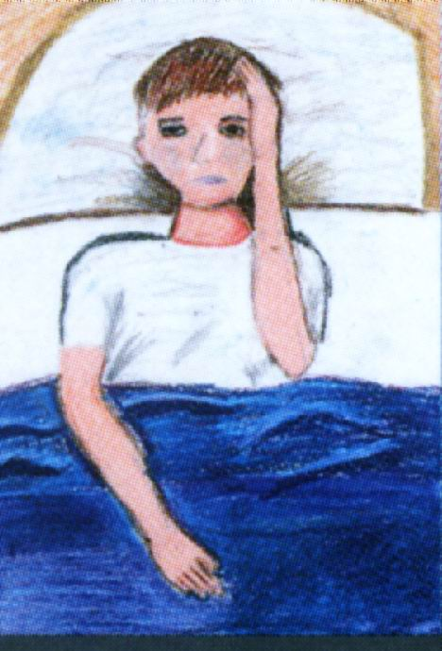
Types of Headache
Acute Headaches
Chronic Headaches

Slide 7
Acute Headache
Acute Headache
Patient Febrile
Patient Afebrile

Slide 8
Acute Headache
Patient Febrile
No Nuchal Rigidity
Nuchal Rigidity
General Examination
Sinus X-ray if Indicated
Lumbar Puncture
Treat Underlying Illness
Follow Until Well
Normal CSF
U/A, CXR
Look for Neck &
Head Infections
WBC in CSF
Meningitis

Slide 9
Acute Headache
Patient Afebrile
Normal Neurologic
Findings
Abnormal Neurologic Findings
or Nuchal Rigidity
Ask about drug use
Check BP & CBC
Neuroimaging
If normal follow for possible
Chronic headache or intracranial
mass lesion
No Mass
Mass
Lumbar Puncture
WBC in CSF (Meningitis)
RBC in CSF (SAH)

Slide 10
Chronic Headache
History:
Description of headache, Change over time,
Family history
Examination:
Normal Neurologic Findings
Abnormal Neurologic Findings
Increasingly Severe Headache
Neuroimaging

Slide 11
Chronic Headache
CT Scan or MRI
Mass
Normal
Lumbar Puncture
Normal
Increased Pressure
Normal Cells
Protein, Glucose
Cells
Migraine
Tension Headache
Pseudotumor Cerebri
Chronic Meningitis
Notes:
Migraine Criteria at least 3 of the 6 followings:
Family history of migraine
Aura
Throbbing quality
Unilaterality
Nausea and or vomiting
Abdominal pains

Slide 12
Chronic Headache
Normal Neurologic
Findings
Episodic, Nonprogressive
Headache
Criteria for Migraine
Present
Absent
Migraine
Episodic Headache
Persistent Headache
R/O Hypertensive Headache
Occipital Neuralgia
TM Joint Dysfunction
Muscle Contraction
Sinus & Occular Disorders
Tension
Muscle Contraction
Psychogenic Disorders

Slide 13
IHS Criteria for Migraine

Slide 14
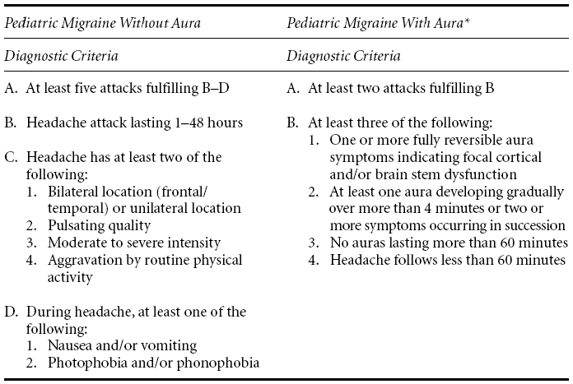
Revised IHS Criteria

Slide 15
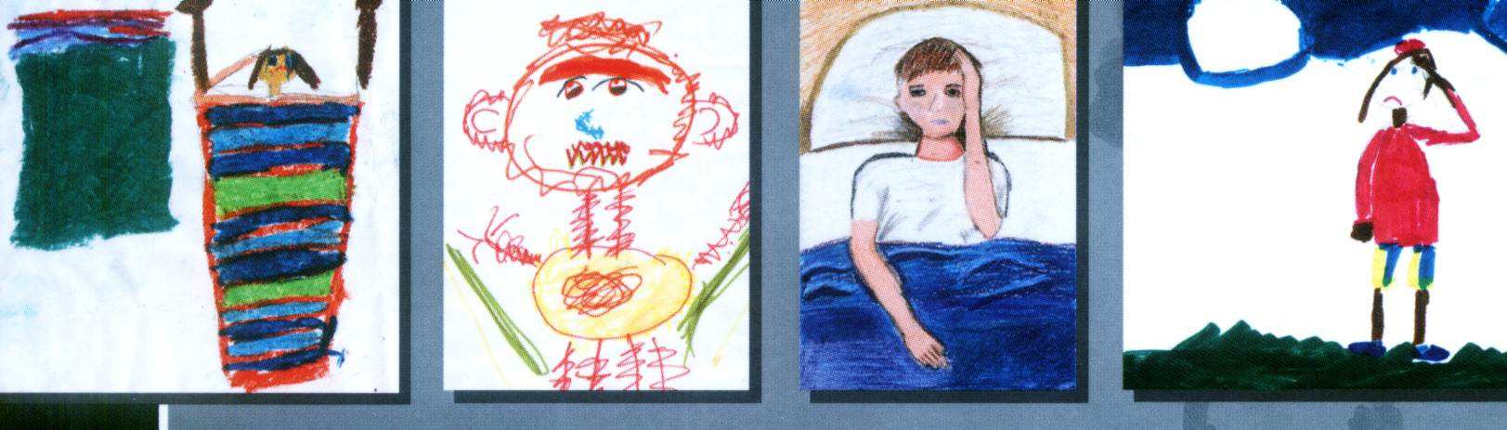

موفق باشيد!

